Slide 1

Digital Slides Seminary
Thaís Ferrarini Tavares, MD / Advisor: Larissa Bastos Eloy da Costa, MD, PhD
State University of Campinas - Unicamp
Notes:
Good afternoon, welcome to the Digital Slides Seminary!
My name is Thaís, my advisor is Doctor Larissa and we are from Unicamp.

Slide 2

Disclosure of Relevant Financial Relationships
Doctor Thaís Ferrarini Tavares declares she has no
conflict(s) of interest to disclose
Specify if affirmative: any relevant financial relationship WITH COMMERCIAL INTERESTS
within the past 12 months, which relates to the content of this educational activity and creates a conflict of interest
RDC Nº 96/08 da ANVISA
Notes:
I don't have conflicts of interest to disclose.

Slide 3
Brief Case Presentation
A 32-year-old male
Ulcerative colitis (UC)
Thrombophilia (thrombosis in the lower limbs twice)
2020 → Splenomegaly (splenic craniocaudal length of 15 cm) and splenic vein dilatation
Portal vein with preserved flow
2021 → Oesophageal varices
UC in a moderate activity → Started with Azathioprine (AZA) → Remission
Underlying diseases
Signs of portal
hypertension
Notes:
A thirty-two-year-old male with diagnoses of ulcerative colitis (UC) and thrombophilia (he already had thrombosis in the lower limbs twice).
In twenty-twenty he began with splenomegaly (the craniocaudal length of fifteen centimeters) and splenic vein dilatation, but, the portal vein flow was preserved.
In twenty-twenty-one he presented oesophageal varices and moderate activity of UC. Therefore, Azathioprine – AZA was prescribed with consequent remission of this disease.

Slide 4
Brief Case Presentation
2023 → Ectasia of portal and splenic veins
Elevated serum of gamma-glutamyltransferase (GGT) levels
93 U/L → 910 U/L (range: 9 - 64 U/L)
Elevated serum GGT levels
Liver biopsy Portal Hypertension
Primary Sclerosing Cholangitis?
Notes:
Two years later, during the follow-up, were identified ectasia of portal and splenic veins, in addition to a significant increase in serum levels of GGT.
A liver biopsy was performed to identify the cause of the elevated serum GGT and investigate portal hypertension and a possible primary sclerosing cholangitis.

Slide 5
Microscopic Findings
Absence of cirrhosis
Missing of the portal vein branch
Narrowing of the porta vein branch lumen
Herniated portal vein branch
Hypervascularized portal tracts
Sinusoidal dilatation
Notes:
Microscopic findings include absence of cirrhosis, missing the portal vein branch, narrowing of the porta vein branch lumen, herniated portal vein branch, hypervascularized portal tracts and sinusoidal dilatation.

Slide 6
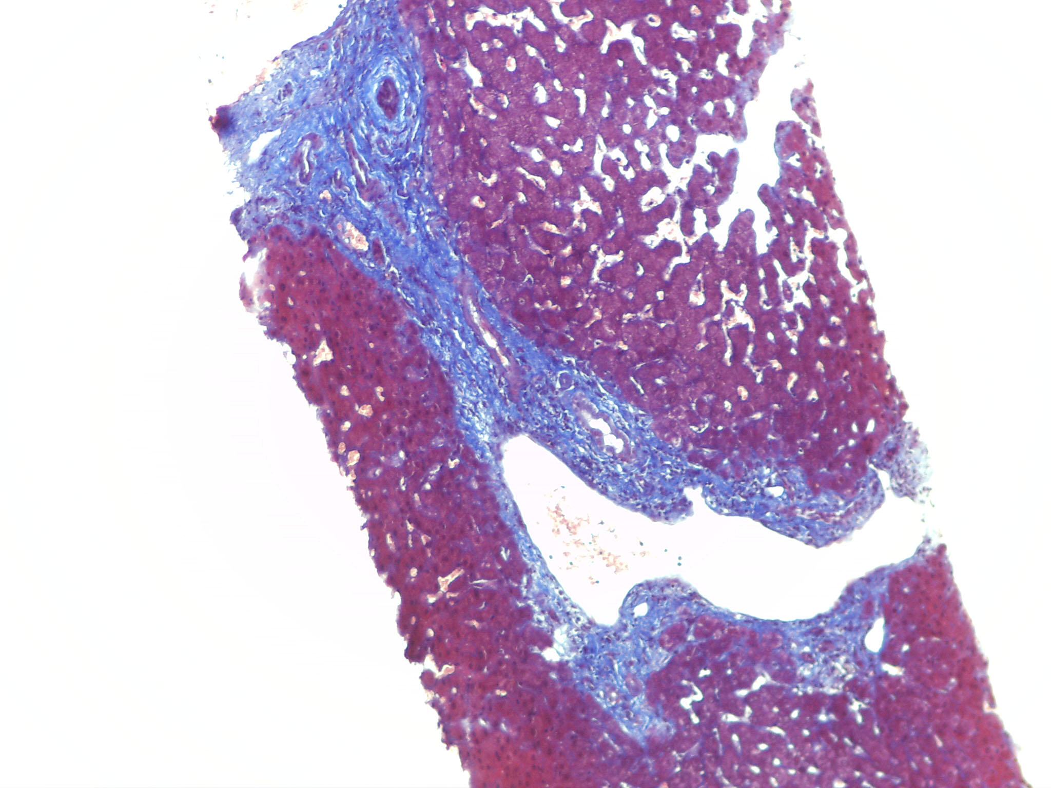
Notes:
In this image, brings attention:
- Herniated portal vein branch
- Hypervascularized portal tract
- Sinusoidal dilatation

Slide 7
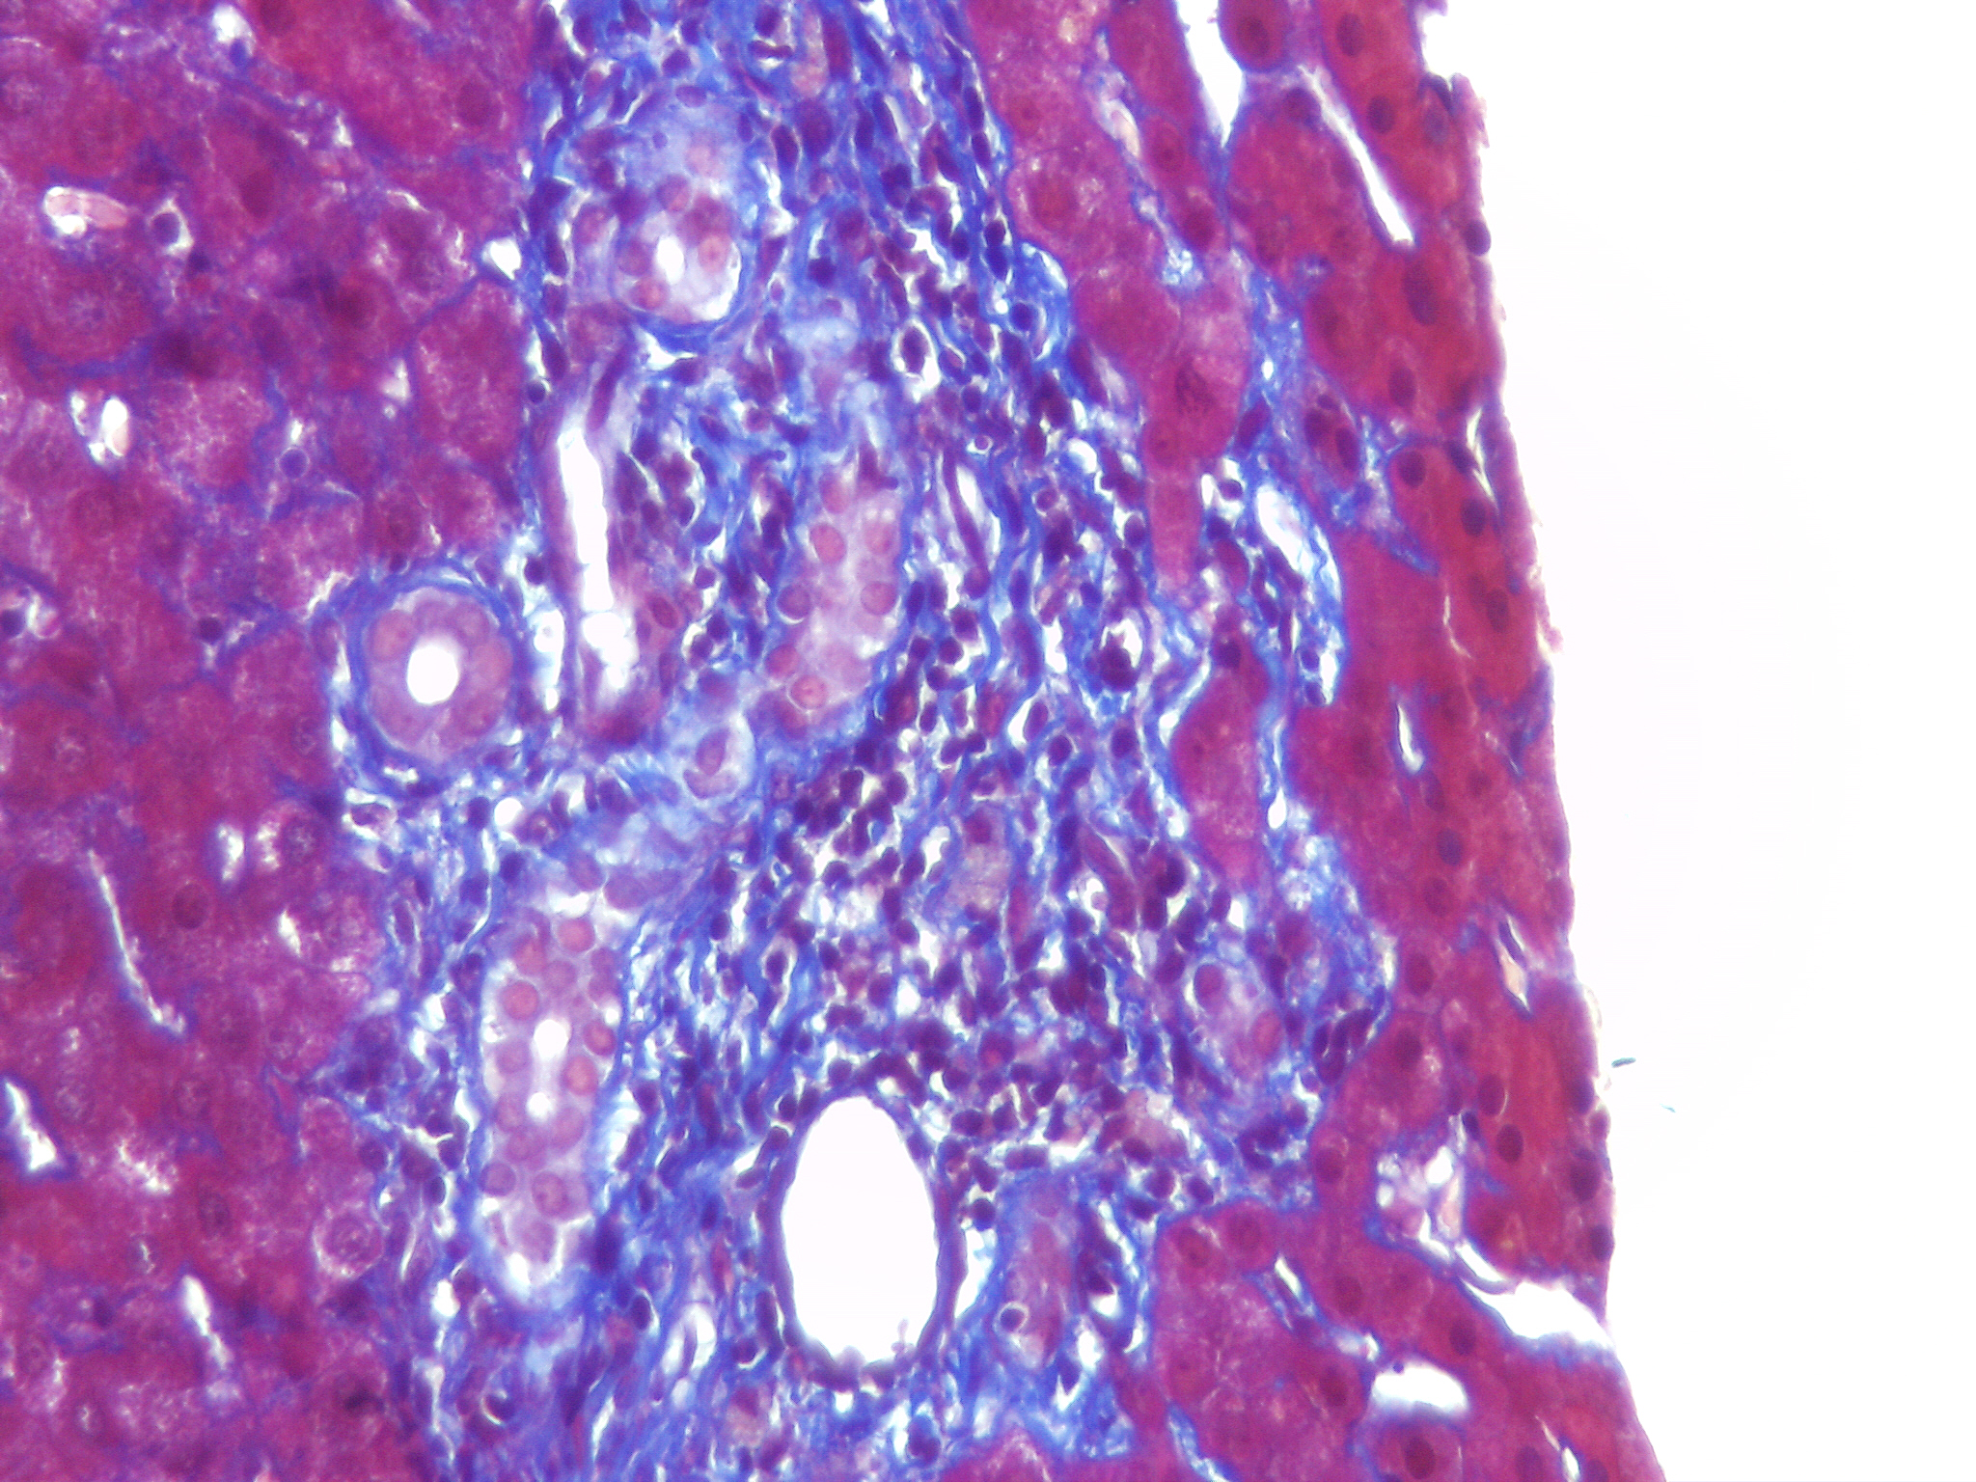
Microscopic Findings
Notes:
This other picture shows the narrowing of the lumen of the portal vein branch.

Slide 8
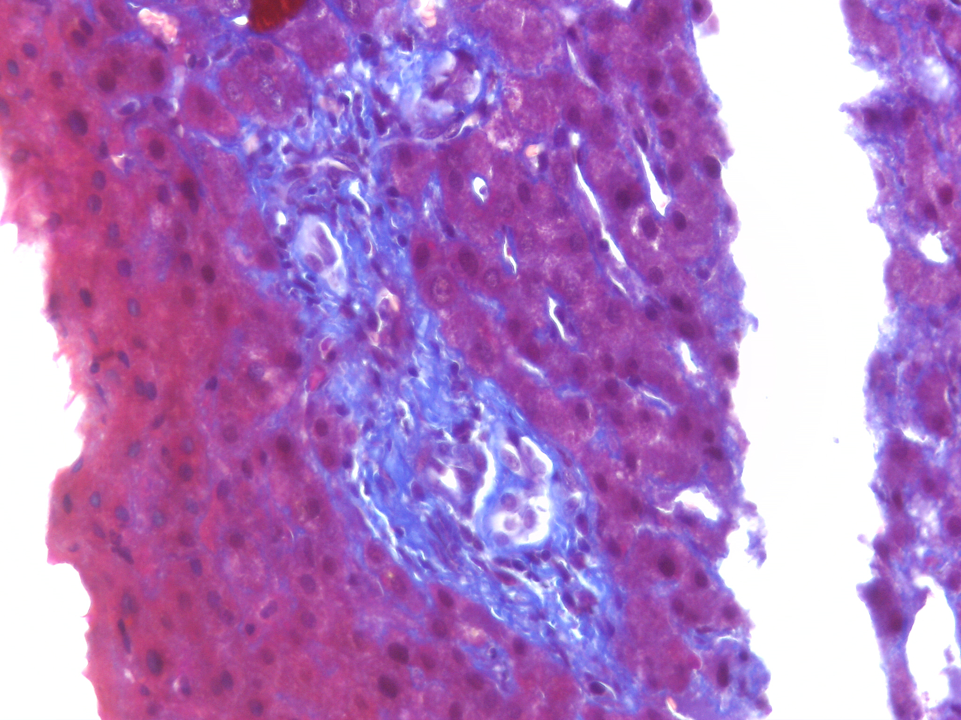
Microscopic Findings
Notes:
And, in this one, the missing portal vein branch.

Slide 9
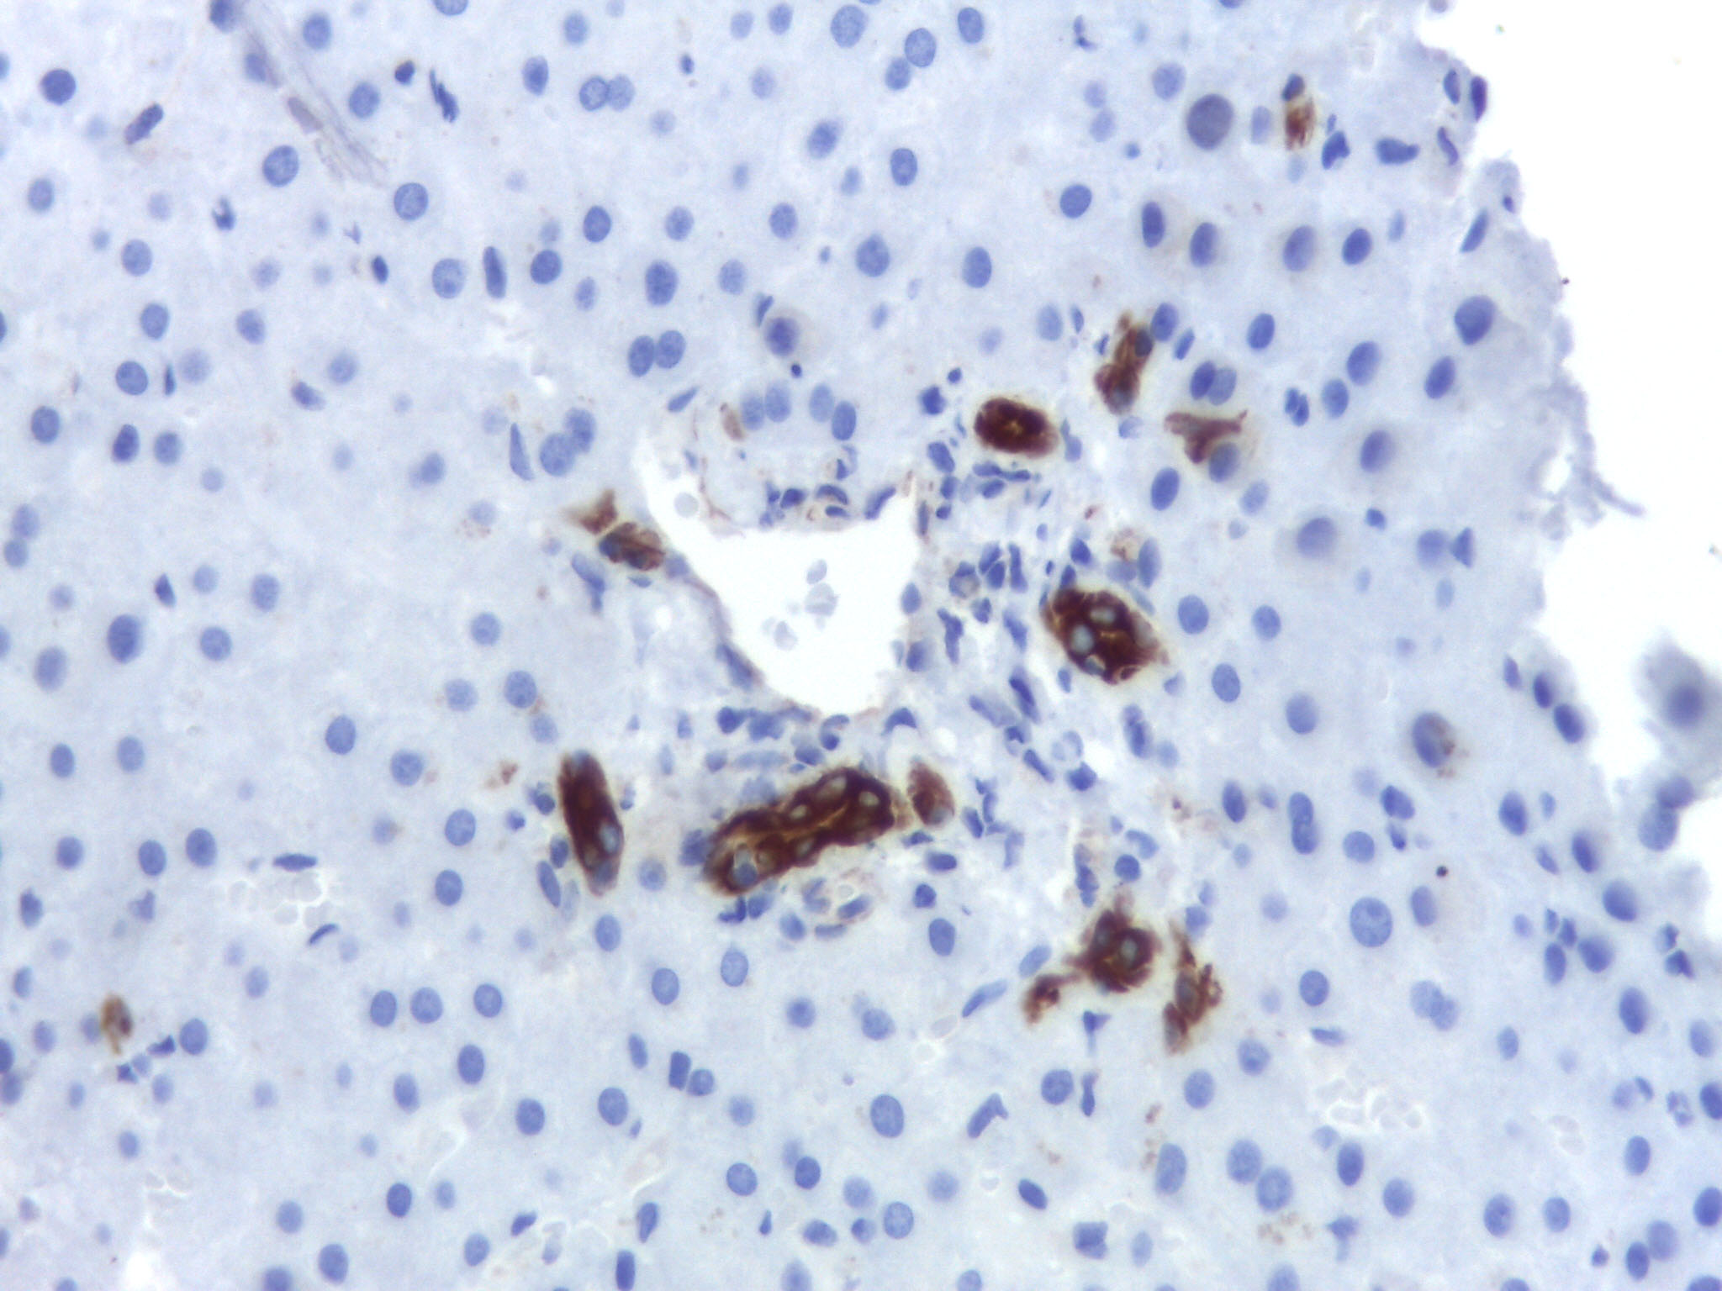
CK7
Notes:
With CK7, we see no expression in periportal hepatocytes, the absence of ductopenia and no signs of primary sclerosing cholangitis.

Slide 10
Discussion
What is the diagnosis?
Porto-sinusoidal vascular disease (PSVD)
Notes:
What is the diagnosis?
Now, you can see the digital slides. The first two are about this case. The third slide is about a counterpoint case.
...
The diagnosis is Porto-sinusoidal vascular disease (PSVD)

Slide 11
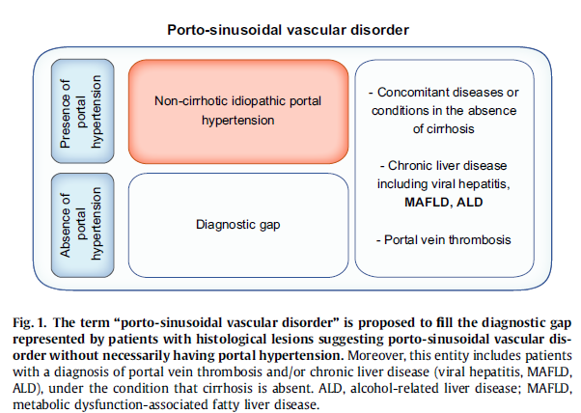
(INCPH)
De Gottardi A, Sempoux C, Berzigotti A. Porto-sinusoidal vascular disorder. Journal of Hepatology 2022; 77: 1124–1135.
Notes:
In some patients, portal hypertension is observed in the absence of cirrhosis and in the absence of portal vein or hepatic vein obstruction. This condition is called non-cirrhotic portal hypertension. Moreover, according to the definition of NCPH, chronic liver diseases are excluded, adding the term idiopathic. However, knowing that early stages of these liver diseases may coexist with the presence of portal sinusoidal alterations on liver biopsy, even without portal hypertension, and added to the fact that portal vein thrombosis may be one of the causes, as well as a consequence of NCPH, a diagnostic gap was identified. So, PSVD was proposed to fill this, including patients with histological findings with or without portal hypertension, and also including some liver diseases and portal vein thrombosis.

Slide 12
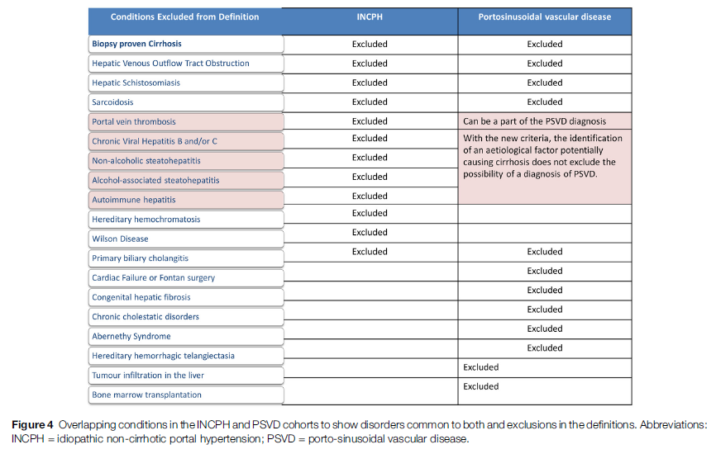
Premkumar M, Anand AC. Porto-sinusoidal Vascular Disease: Classification and Clinical Relevance. Journal of Clinical and Experimental Hepatology 2024; 14: 101396.
Notes:
These conditions are included and also portal vein thrombosis can be incorporated into the definition.

Slide 13
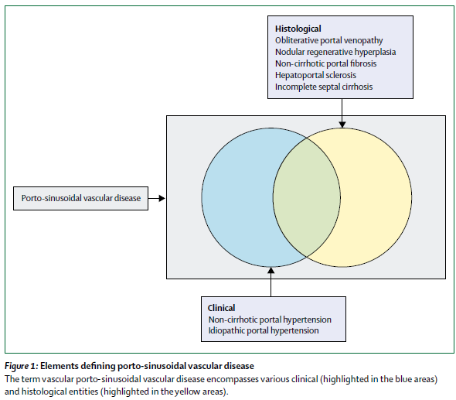
De Gottardi A, Rautou P-E, Schouten J, Rubbia-Brandt L, Leebeek F, Trebicka J, et al. Porto-sinusoidal vascular disease: proposal and description of a novel entity. Lancet Gastroenterol Hepatol 2019; 4: 399-411.
Notes:
The elements that achieve this diagnosis are histological and clinical findings.

Slide 14
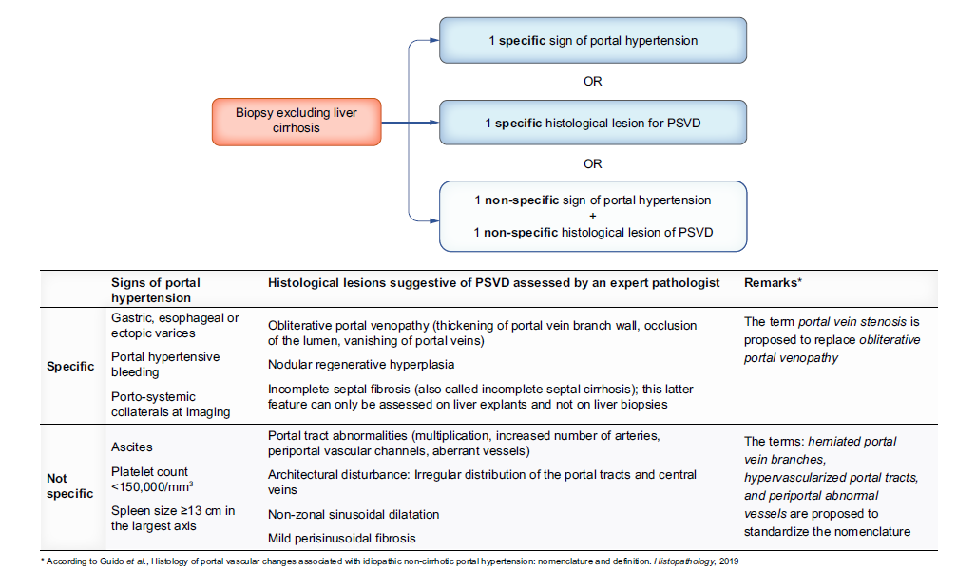
De Gottardi A, Sempoux C, Berzigotti A. Porto-sinusoidal vascular disorder. Journal of Hepatology 2022; 77: 1124–1135.
Notes:
For building the diagnosis of PSVD is first necessary a biopsy without liver cirrhosis. The criteria are:
- one specific sign of PH – as gastric, esophageal or ectopic varices, portal hypertensive bleending and porto-systemic collaterals at imaging

Slide 15
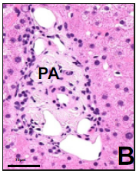
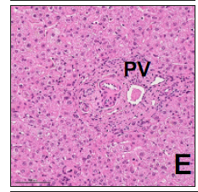
De Gottardi A, Sempoux C, Berzigotti A. Porto-sinusoidal vascular disorder. Journal of Hepatology 2022; 77: 1124–1135.
Notes:
OR
- one specific histological lesion – that are obliterative portal venopathy (thickening of portal veins branch wall, occlusion of the lumen, vanishing of portal veins)
B) Absence of portal vein
E) Portal vein branch is small, dificult to recognise, with narrowing of its lumen

Slide 16
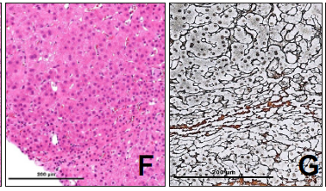
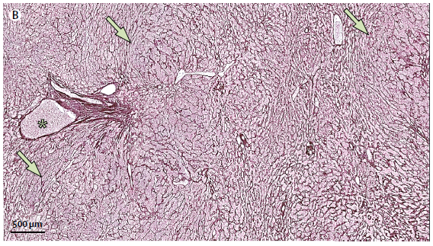
De Gottardi A, Rautou P-E, Schouten J, Rubbia-Brandt L, Leebeek F, Trebicka J, et al. Porto-sinusoidal vascular disease: proposal and description of a novel entity. Lancet Gastroenterol Hepatol 2019; 4: 399-411
De Gottardi A, Sempoux C, Berzigotti A. Porto-sinusoidal vascular disorder. Journal of Hepatology 2022; 77: 1124–1135.
Notes:
Nodular regenerative hyperplasia
- The small hyperplastic nodules close to atrophic hepatocytes plates seen are highlighted by the Reticulin stain.

Slide 17
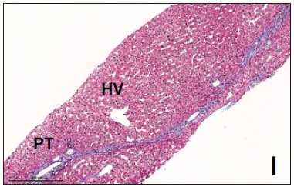
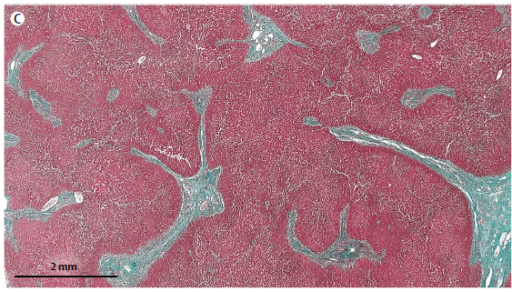
De Gottardi A, Rautou P-E, Schouten J, Rubbia-Brandt L, Leebeek F, Trebicka J, et al. Porto-sinusoidal vascular disease: proposal and description of a novel entity. Lancet Gastroenterol Hepatol 2019; 4: 399-411
De Gottardi A, Sempoux C, Berzigotti A. Porto-sinusoidal vascular disorder. Journal of Hepatology 2022; 77: 1124–1135.
Notes:
Incomplete septal fibrosis
I) Thin septa are crossing the liver parenchyma creating some nodular architecture, with approximation of the hepatic vein to the portal tracts.
C) Portal tracts are enlarged and prolonged by incomplete thin and blind-ended septa.

Slide 18
De Gottardi A, Sempoux C, Berzigotti A. Porto-sinusoidal vascular disorder. Journal of Hepatology 2022; 77: 1124–1135.
Notes:
OR
- one non-specific sign of PH – they are ascites, platelet count smaller than one hundred fifty thousand and spleen size more or similar thirteen centimeters in the largest axis

Slide 19
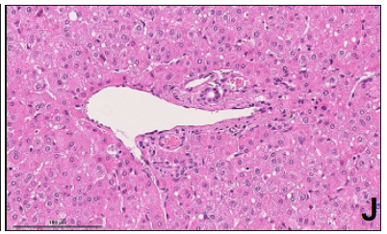
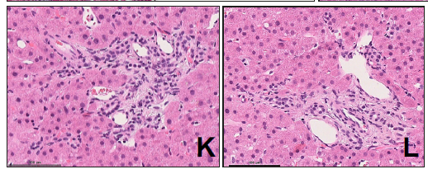
De Gottardi A, Sempoux C, Berzigotti A. Porto-sinusoidal vascular disorder. Journal of Hepatology 2022; 77: 1124–1135.
Notes:
PLUS
one non-specific histological lesion – that are portal tract abnormalities (multiplication, increased number of arteries, periportal vascular channels, aberrant vessels), architectural disturbance, with irregular distribution of the portal tracts and central veins, non-zonal dilatation and mild perisinusoidal fibrosis.
J) Herniated portal vein, a vein in direct contact with the hepatocyte plates
K and L) Hypervascularized portal tract and abnormal periportal vessels

Slide 20
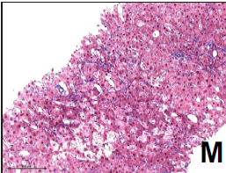
De Gottardi A, Sempoux C, Berzigotti A. Porto-sinusoidal vascular disorder. Journal of Hepatology 2022; 77: 1124–1135.
Notes:
M) Sinusoidal congestion with delicate perisinusoidal fibrosis

Slide 21
De Gottardi A, Sempoux C, Berzigotti A. Porto-sinusoidal vascular disorder. Journal of Hepatology 2022; 77: 1124–1135.
Notes:
In our case we have those highlighted in red.

Slide 22
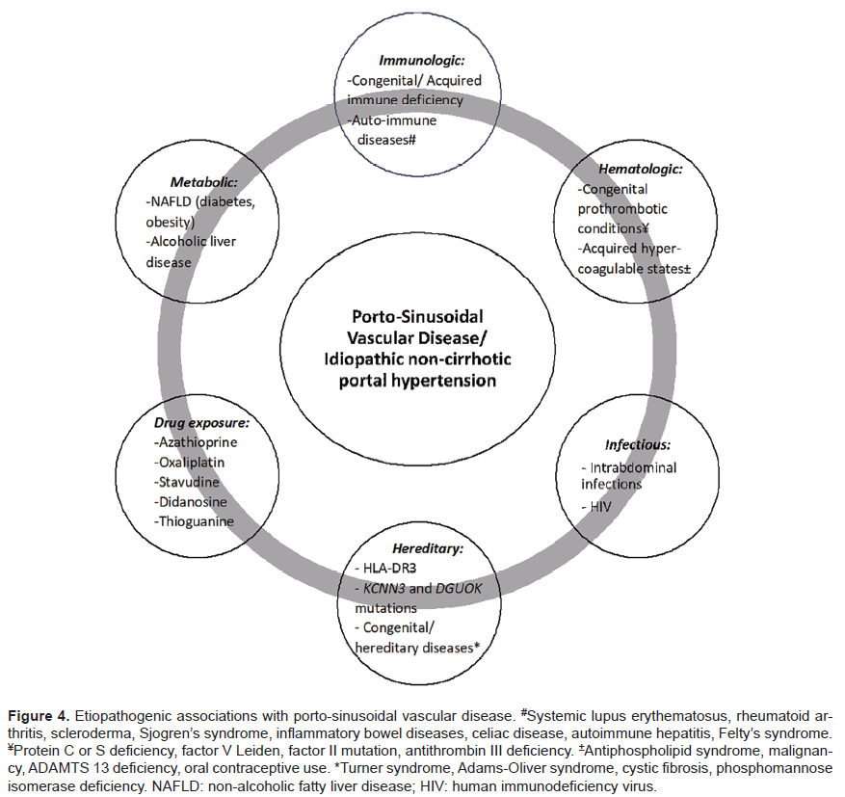
Kmeida M, Liub X, Ballentinec S, Leea H. Idiopathic Non-Cirrhotic Portal Hypertension and Porto- Sinusoidal Vascular Disease: Review of Current Data. Gastroenterol Res. 2021; 14(2): 49-65.
Notes:
It has already been described various etiopathogenic associations with PSVD.

Slide 23
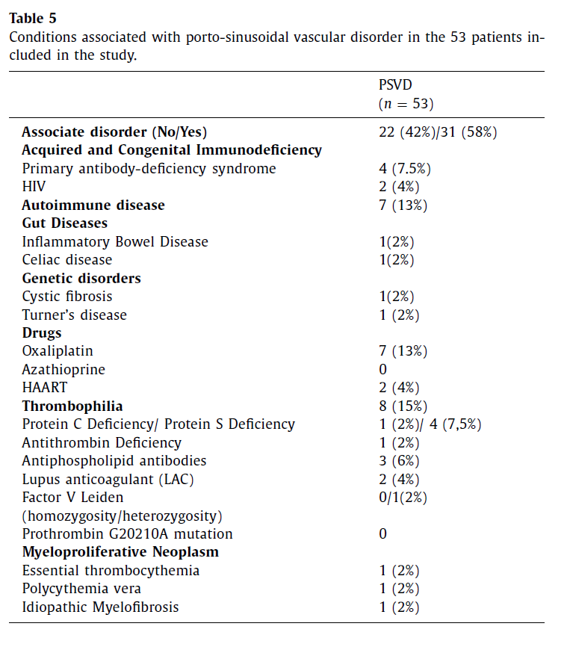
Gioia S, Baiocchini A, d’Amati G, et al. Porto-sinusoidal vascular disorder (PSVD): Application of new diagnostic criteria in a multicenter cohort of patients. Digestive and Liver Disease 2024; 56: 291–296.
Notes:
A more recent study described these conditions:
- Acquired and Congenital Immunodeficiency
- Autoimmune diseases
- Gut diseases – and here we have the inflammatory bowel disease
- Genetic disorders
- Drugs – azathioprine should receive attention!
- Thrombophilia
- and Myeloproliferative neoplasm

Slide 24
Thrombophilia
Several lines of evidence suggest a role for microthrombi or platelet aggregates in the pathogenesis of PSVD
The most common histological findings are thickening or obliteration of intra-hepatic portal venules, which probably result from previous thrombotic events
Trombophilic factor
AND / OR
Decreased portal flow velocity induced by PSVD
May induce an imbalance between the portal and arterial hepatic inflow resulting in sinusoidal vascular abnormalities
Portal vein thrombosis
De Gottardi A, Rautou P-E, Schouten J, Rubbia-Brandt L, Leebeek F, Trebicka J, et al. Porto-sinusoidal vascular disease: proposal and description of a novel entity. Lancet Gastroenterol Hepatol 2019; 4: 399-411
De Gottardi A, Sempoux C, Berzigotti A. Porto-sinusoidal vascular disorder. Journal of Hepatology 2022; 77: 1124–1135.
Notes:
Now, I will show the underlying situations that were found in our case and how they are related with to PSVD, starting with thrombophilia:
- Several lines of evidence suggest a role for microthrombi or platelet aggregates in the pathogenesis of PSVD
- The most common histological findings are thickening or obliteration of intra-hepatic portal venules, which probably result from previous thrombotic events.
Research has suggested that trombophilic factor AND / OR decreased portal flow velocity induced by PSVD → favours portal vein thrombosis → which may induce an imbalance between the portal and arterial hepatic inflow resulting in sinusoidal vascular abnormalities.

Slide 25
Inflammatory
Bowel Disease
(IBD)
The prevalence of PSVD in patients with IBD was reported to be 6%
Chronic and acute inflammation can exacerbate immunologic and prothrombotic risk factors, leading to the promotion of thrombogenesis and portal vein stenosis - ↑ TNF-α
Extensive small intestinal involvement may result in ↓ absorption of vitamin B12, B6 and folic acid, leading to hyperhomocysteinemia and the ↑ of risk of thrombosis in the branches of the portal vein
Patients with PSVD may have impaired intestinal permeability and endotoxemia correlating with a pro-aggregating /procoagulant state
The histological lesions observed in PSVD, including lobular and non-necrotising, non-fibrosing granulomas, disruption of the sinusoid lining, and portal vein endothelialitis, consistently suggest a possible role for intrasinusoidal T lymphocytes in its pathogenesis
Pugliese N, Giuli L, Mastrorocco E, et al. Exploring the link: Porto-sinusoidal vascular disorder and inflammatory bowel disease – A comprehensive narrative review. Digestive and Liver Disease, 2024; 10: 19-32.
Gioia S, Carnevale R, Tavano D, et al. Association between gut-derived endotoxins and porto-sinusoidal vascular disorder with portal hypertension. Aliment Pharmacol Therapeutics, 2023; 58:11-12.
De Gottardi A, Rautou P-E, Schouten J, Rubbia-Brandt L, Leebeek F, Trebicka J, et al. Porto-sinusoidal vascular disease: proposal and description of a novel entity. Lancet Gastroenterol Hepatol 2019; 4: 399-411
Notes:
About the inflammatory bowel disease:
- The prevalence of this association was reported to be six percent.
- Chronic and acute inflammation can exacerbate immunologic and prothrombotic risk factors
- Extensive small intestinal involvement leading to hyperhomocysteinemia and the increasinf of risk of thrombosis in the branches of the portal vein.
- Patients with PSVD may have impaired intestinal permeability and endotoxemia
- The histological lesions observed in PSVD, consistently suggest a possible role for intrasinusoidal T lymphocytes in its pathogenesis.

Slide 26
Inflammatory Bowel Disease + PSVD
It has been identified as potential risk factors for the development of PSVD in IBD patients:
- Male sex
Small bowel strictures or resections longer than 50 cm prior to or after AZA treatment
Severity of IBD
Prolonged administration of AZA
Pugliese N, Giuli L, Mastrorocco E, et al. Exploring the link: Porto-sinusoidal vascular disorder and inflammatory bowel disease – A comprehensive narrative review. Digestive and Liver Disease, 2024; 10: 19-32.
Notes:
It has been identified as potential risk factors for the development of PSVD in IBD patients: male sex, small bowel strictures or resections longer than fifty centimeters prior to or after AZA treatment, severity of IBD and prolonged administration of AZA

Slide 27
Azathioprine (AZA)
PSVD is a rare but well-recognized side effect → It generally occurs between 3 months and 3 years after initiation of thiopurine therapy
Most patients have clinical signs of PH at the time of diagnosis, while others have only blood test abnormalities such as thrombocytopenia and elevated transaminases and/or GGT.
AZA (a thiopurine) is metabolized into active compounds: 6-thioguanine nucleotides (6-TGN) within immune cells
High levels of 6-TGN
- dose-dependent injury
- genetic factors
- ↓ activity of thiopurine
S-methyltransferase
Damage to sinusoidal endothelial cells and small hepatic venules (in vitro investigation, AZA induces this damage due to depletion of cellular glutathione)
This leads to non-thrombotic vessel occlusion, which subsequently causes the onset of PH
Pugliese N, Giuli L, Mastrorocco E, et al. Exploring the link: Porto-sinusoidal vascular disorder and inflammatory bowel disease – A comprehensive narrative review. Digestive and Liver Disease, 2024; 10: 19-32.
LiverTox: Clinical and Research Information on Drug-Induced Liver Injury [Internet]. ]. Bethesda (MD): National Institute of Diabetes and Digestive and Kidney Diseases; 2012 -.
Notes:
About the AZA:
PSVD is a rare but well-recognized side effect → It generally occurs between three months and three years after initiation of thiopurine therapy.
Most patients have clinical signs of PH at the time of diagnosis, while others have only blood test abnormalities such as thrombocytopenia and elevated transaminases and/or GGT.
The sequence is:
- AZA (a thiopurine) is a prodrug, which is metabolized into active compounds
- High levels of 6-TGN
- Results in damage to sinusoidal endothelial cells and small hepatic venules
- This leads to non-thrombotic vessel occlusion, which subsequently causes the onset of PH.

Slide 28
Brief Case Presentation
Notes:
To conclude our case, remember this: a patient with IBD and thrombophilia, who already had factors contributing to the development of PSVD, had the use of AZA as a possible trigger for the diagnosis of PSVD.
This hypothesis is supported by when the use of AZA was discontinued, he has to a significant decrease in serum levels of GGT.

Slide 29
Brief Case Presentation 2
Counterpoint – Acute DILI induced by Azathioprine
A 35-year-old female
Autoimmune hepatitis →
Started use of Azathioprine
Eight weeks after → Elevated serum of transaminases levels
Liver biopsy → Cholestatic hepatitis
Underlying diseases
Alanine aminotransferase (ALT)
37 → 900 U/L (range: < 35 U/L)
Aspartate aminotransferase (AST)
49 → 1507 U/L (range: < 35 U/L)
Notes:
Just to make a counterpoint, we are bringing this case of acute DILI induced by AZA, of a thirty-five-year-old female, with autoimmune hepatitis, who started using AZA and eight weeks later she developed a significant increase in serum levels of transaminases. In our liver biopsy, the histologic pattern is cholestatic hepatitis.

Slide 30
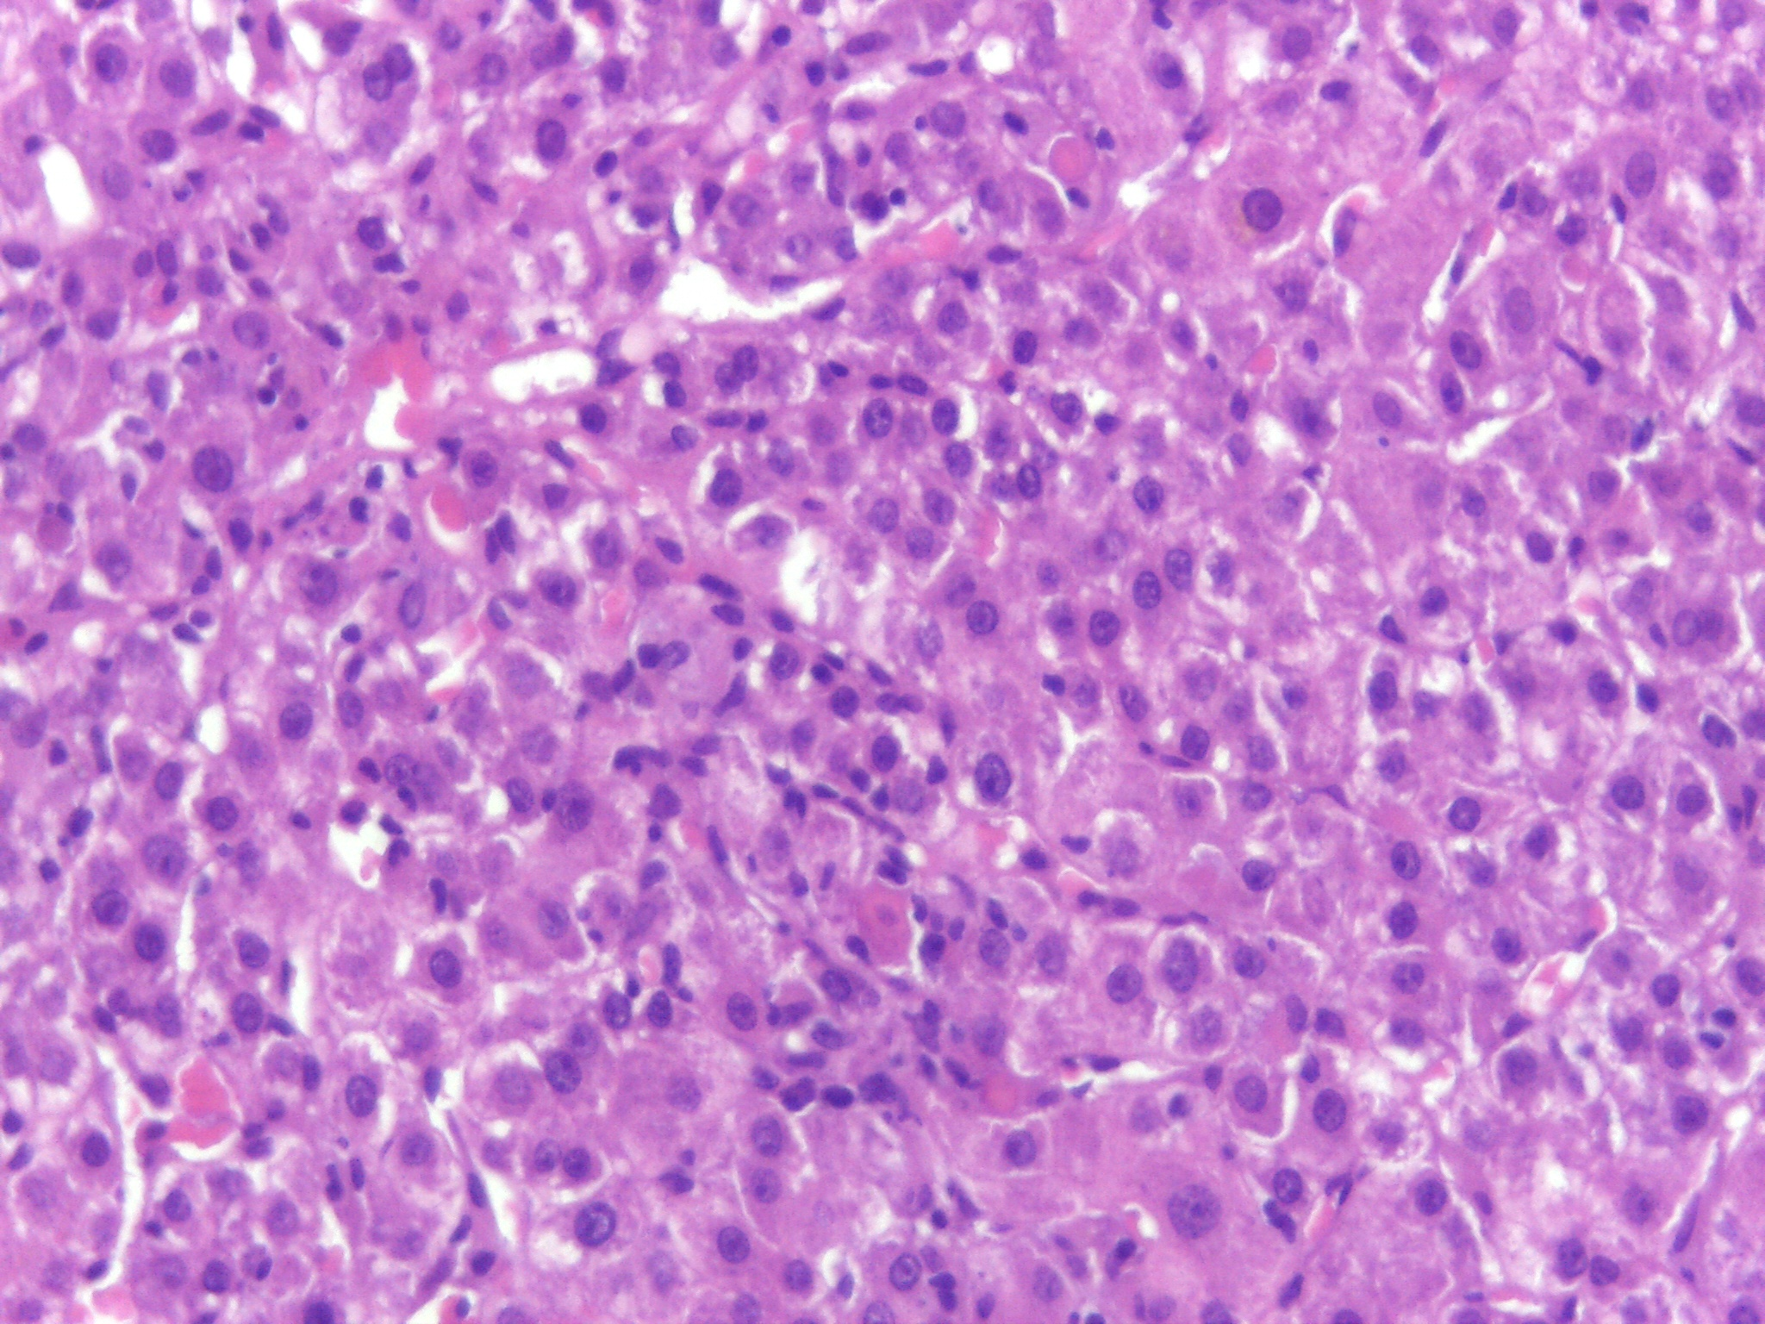
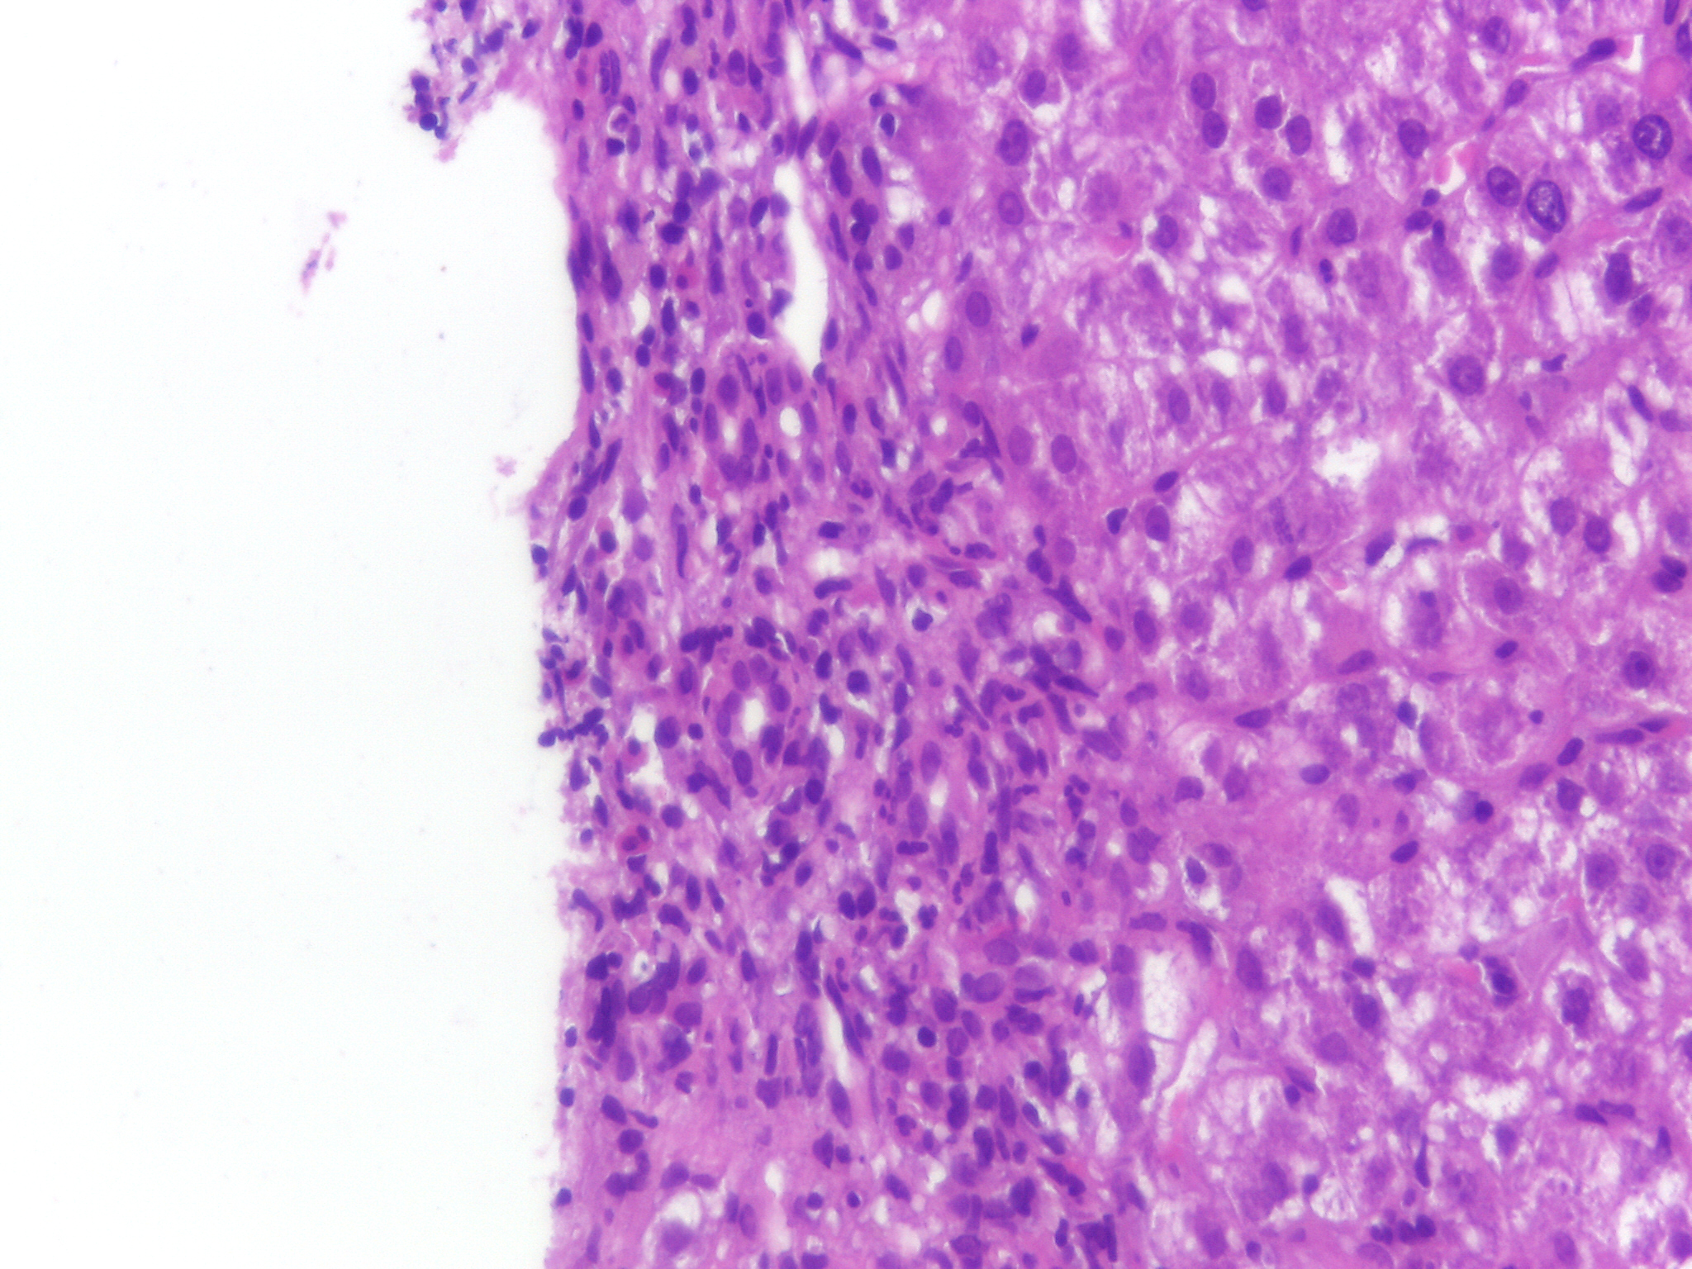
Microscopic Findings
Notes:
1- In this case identifies lobular necrosis, apoptotic bodies, regeneration of hepatocytes, and some cholestasis
2- In this second picture there are cholangitis, ductular proliferation and the presence of some eosinophils

Slide 31
Take-Home Messages - PSVD
Subtle findings in liver biopsy! → Always non-cirrhotic!
Combination of aetiologies → Overlap!
Azathioprine use → Can be a trigger!
Acute
The first year of starting therapy
Cholestatic hepatitis
Chronic
1 to 5 years after starting therapy
PSVD
Notes:
For finishing our take-home messages about PSVD are:
- Subtle findings in liver biopsy!- It’s always non-cirrhotic!
- A combination of aetiologies- is frequent and leads to an overlap!
- We should be careful with AZA, it can be a trigger!
Consider acute effects in the first year of starting therapy, with a histological pattern of cholestatic hepatitis. While the chronic effects occur one to five years after starting therapy and can result in PSVD.

Slide 32
References
De Gottardi A, Rautou P-E, Schouten J, Rubbia-Brandt L, Leebeek F, Trebicka J, et al. Porto-sinusoidal vascular disease: proposal and description of a novel entity. Lancet Gastroenterol Hepatol 2019; 4: 399-411.
De Gottardi A, Sempoux C, Berzigotti A. Porto-sinusoidal vascular disorder. Journal of Hepatology 2022; 77: 1124–1135.
Premkumar M, Anand AC. Porto-sinusoidal Vascular Disease: Classification and Clinical Relevance. Journal of Clinical and Experimental Hepatology 2024; 14: 101396.
Kmeida M, Liub X, Ballentinec S, Leea H. Idiopathic Non-Cirrhotic Portal Hypertension and Porto- Sinusoidal Vascular Disease: Review of Current Data. Gastroenterol Res. 2021; 14(2): 49-65.
Gioia S, Baiocchini A, d’Amati G, et al. Porto-sinusoidal vascular disorder (PSVD): Application of new diagnostic criteria in a multicenter cohort of patients. Digestive and Liver Disease 2024; 56: 291–296.
Pugliese N, Giuli L, Mastrorocco E, et al. Exploring the link: Porto-sinusoidal vascular disorder and inflammatory bowel disease – A comprehensive narrative review. Digestive and Liver Disease, 2024; 10: 19-32.
Gioia S, Carnevale R, Tavano D, et al. Association between gut-derived endotoxins and porto-sinusoidal vascular disorder with portal hypertension. Aliment Pharmacol Therapeutics, 2023; 58:11-12.
LiverTox: Clinical and Research Information on Drug-Induced Liver Injury [Internet]. Bethesda (MD): National Institute of
Diabetes and Digestive and Kidney Diseases; 2012 -.

Slide 33
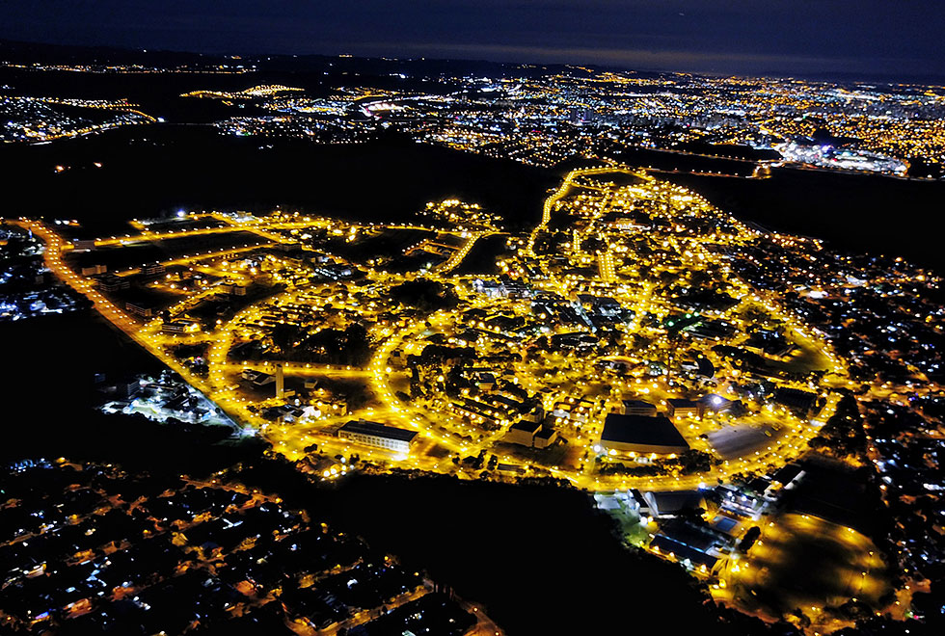
THANK YOU
Notes:
(This is our UNICAMP from above. It is a drone image)

